Slide 1


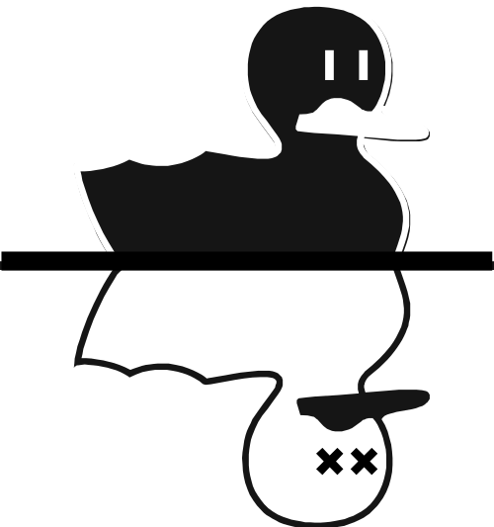


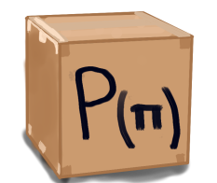
2022
Purple
Teaching Quantum Circuits with Boxes

Slide 2


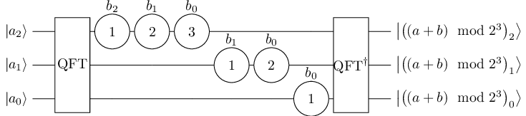
Our Motivation
In order to explain the applications of an algorithm it is necessary to explain what a quantum circuit is and what better with video games. We can motivate the people start in the quantum area with videogames and they find relations with this videogame.
We replace the theory for image of cats and boxes.
Use quantum logic itself as a gaming mechanism for education
Image obtained from: https://www.researchgate.net/figure/Modified-Drapers-adder-example-for-3-qubit-register-a-and-3-bit-classical-constant-b_fig3_340271339

Slide 3
First problem
Using Q# and the idea of having a random number generator using a quantum circuit to find numbers up to 32, this was based on the idea that there is noise in the computer such as the generation of a noisy model.
open Microsoft.Quantum.Arrays;
open Microsoft.Quantum.Measurement;
operation RandomNumber() : Result[] {
use register = Qubit[5] {
// Set qubits in superposition.
for index in 0 .. 10 {
ApplyToEachA(H, register);
CNOT(register[0], register[1]);
CNOT(register[0], register[2]);
CNOT(register[0], register[3]);
CNOT(register[0], register[4]);
CNOT(register[1], register[2]);
CNOT(register[1], register[3]);
CNOT(register[1], register[4]);
CNOT(register[2], register[3]);
CNOT(register[3], register[4]);
CNOT(register[3], register[4]);
X(register[0]);
}
return ForEach(MResetZ, register);
}
}
Quantum Random Number Generator (QRNG)

Slide 4
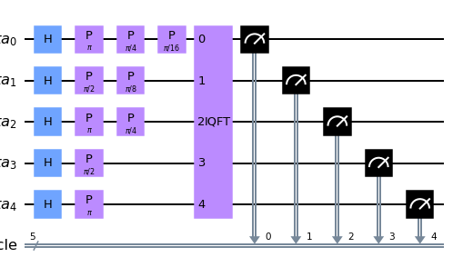
Second problem
Understand the concepts of
Amplitude Amplification
Quantum Fourier Transform
Arithmetic Operations
And using the ionq.qpu
Draper Adder and substract

Slide 5
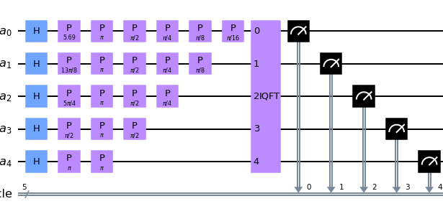
Quantum gaming mechanism
This is the all quantum circuit, we can consider or not certain P gates.

Slide 6
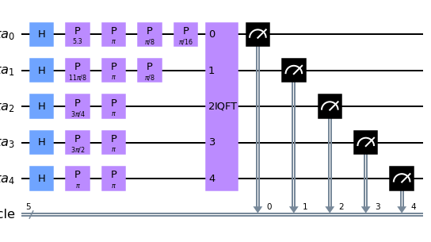
Level 1
Consider all the cats are green or the qubits are in |0> and we need find the correct combination of green and purple cats. That means a combination of |0> and |1> states.
Example the output is |11001>

Slide 7
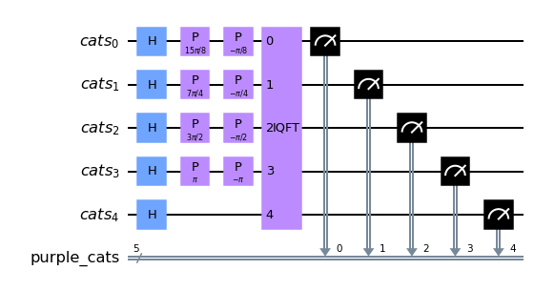
Level 2
Initial state = |11110>
We need add |00010>
Example the output is |11100>

Slide 8
Mechanics(How does it work)
We start out with the cats in superpostion (green cats) which are the qubits.
We use the Draper Method for addition and subtraction.
By using gates in the circuits we can change the color of the cats (i.e. the states of the cats).
The goal is to find the original cats(purple) from the changed cats(green).

Slide 9

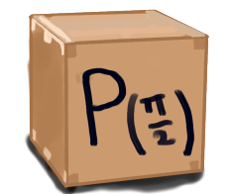
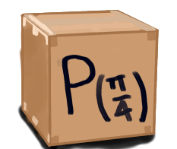
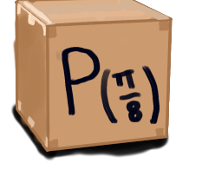
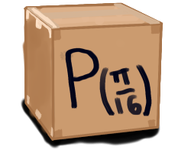
RULES
In order to find the right cats we have a certain number of boxes with a unique rotation.
You can choose to use more or less boxes depending on the structure of the circuit.
5
4
3
2
1

Slide 10


Hints
There are configurations known to find the purple cats.

Slide 11
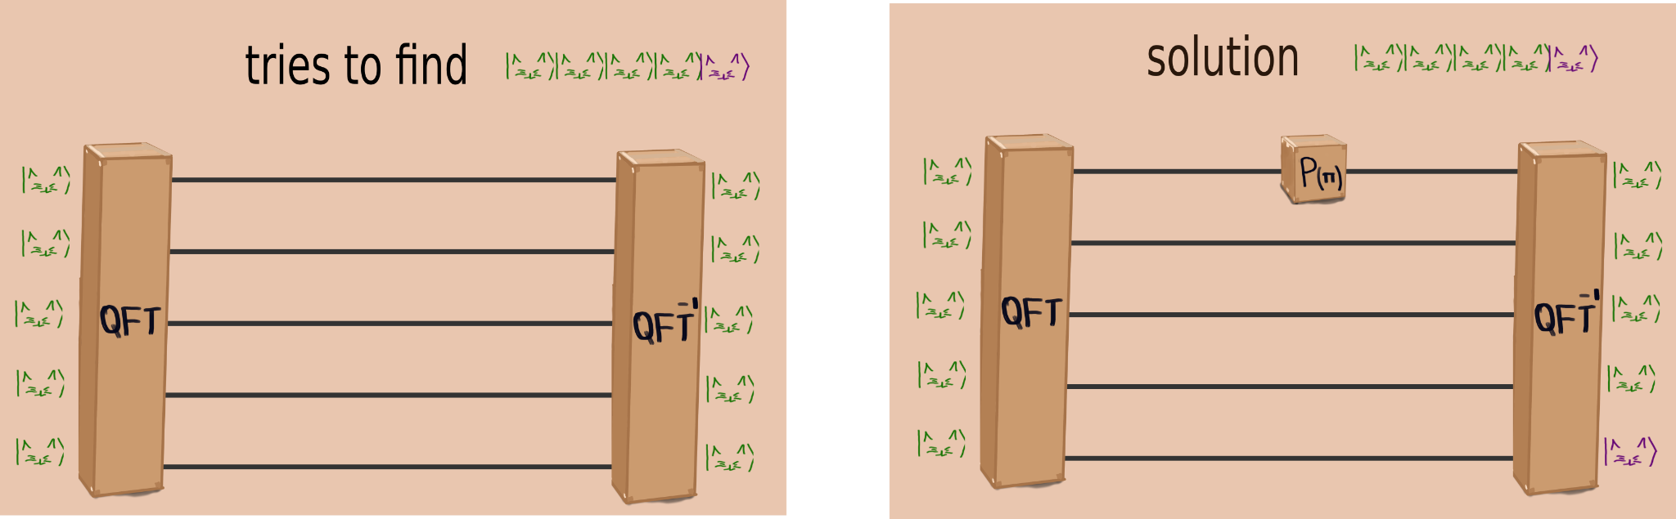
HINT(1)

Slide 12
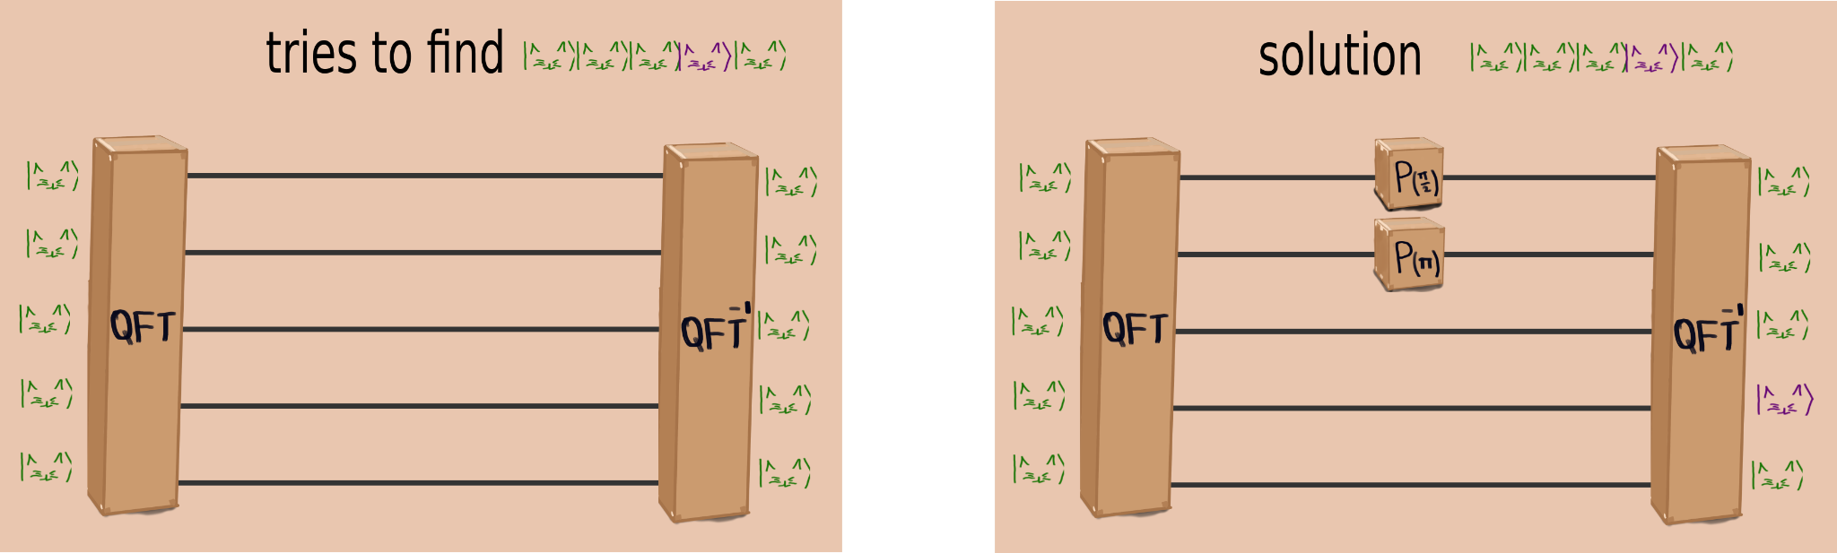
HINT(2)

Slide 13
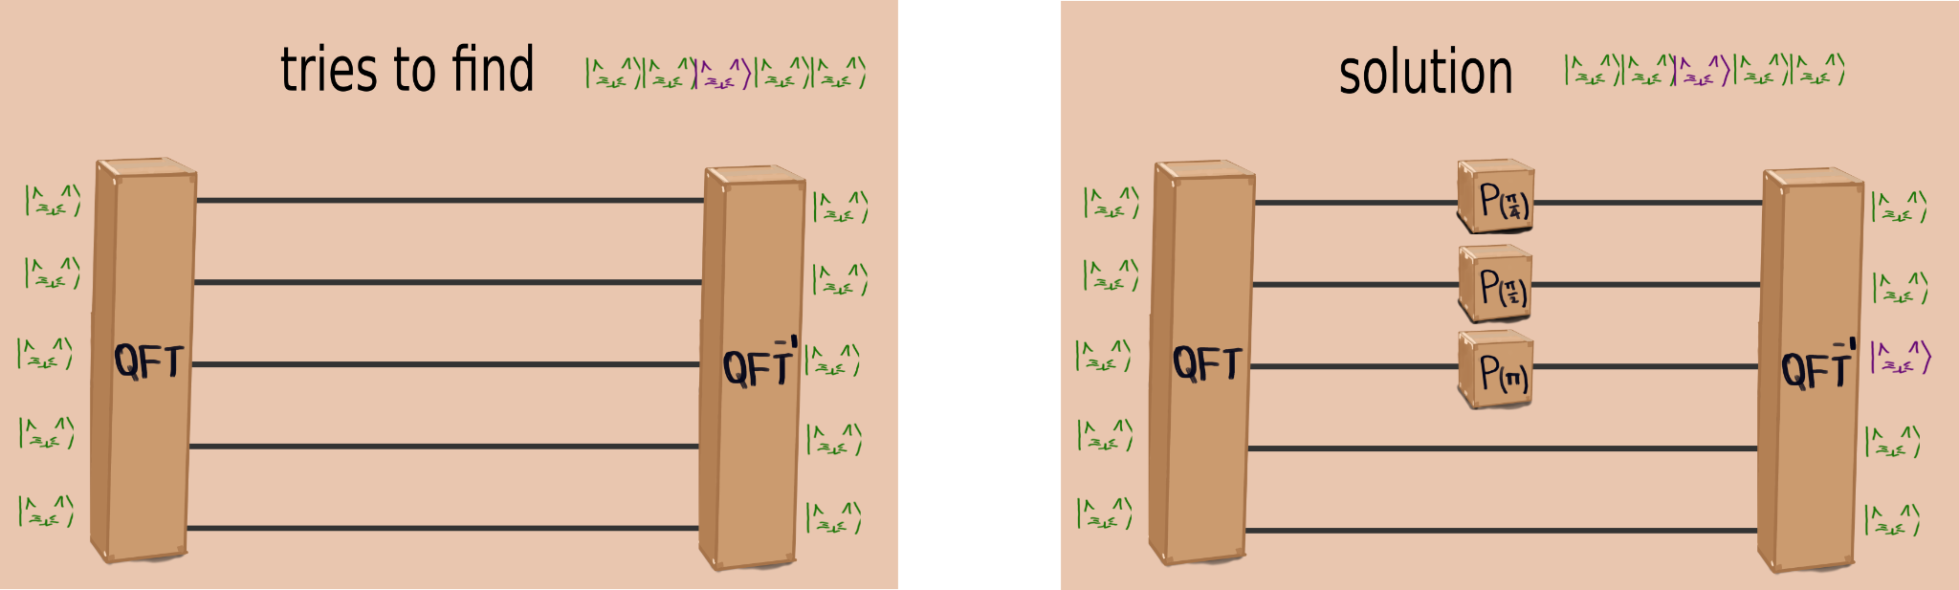
HINT(3)

Slide 14
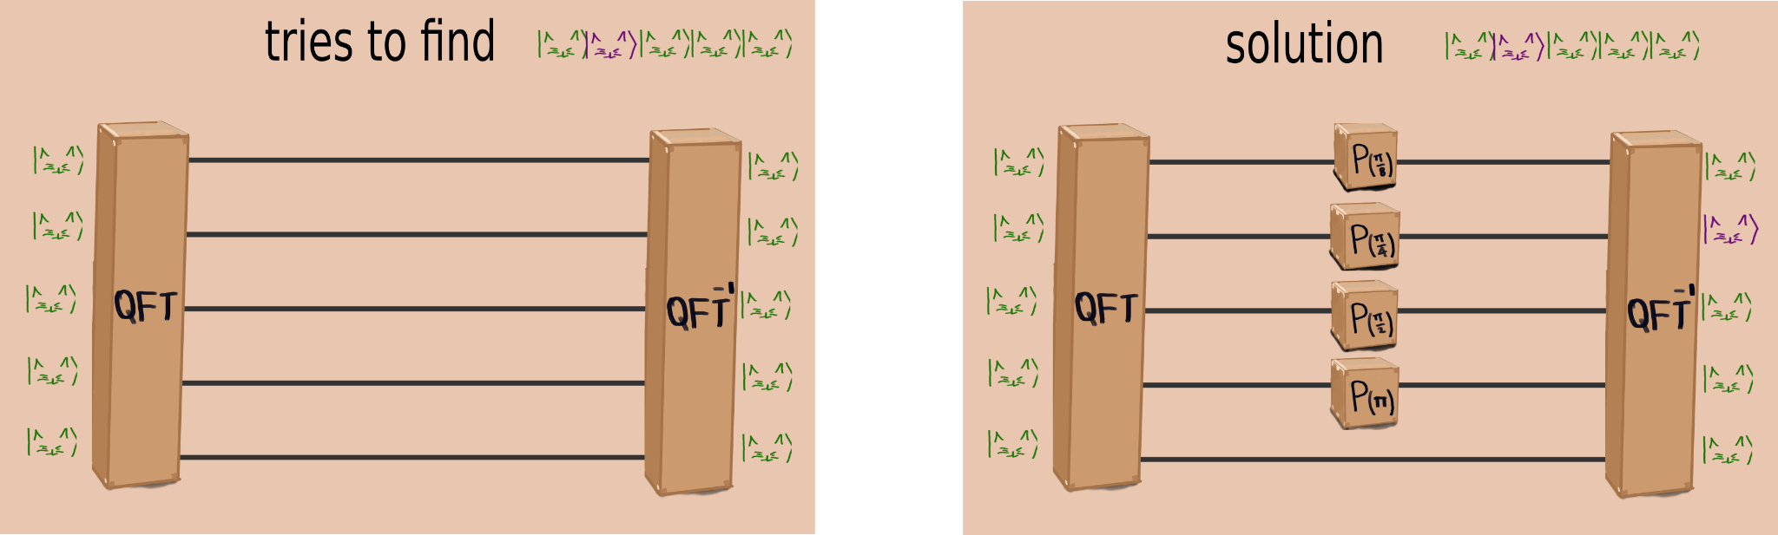
HINT(4)

Slide 15
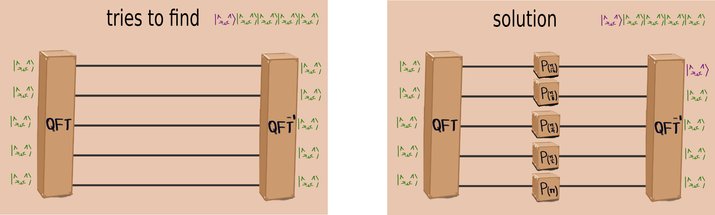
HINT(5)

Slide 16
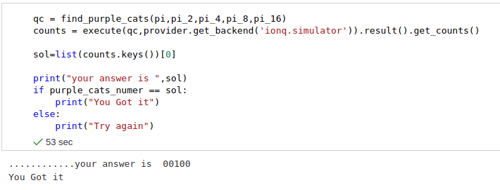
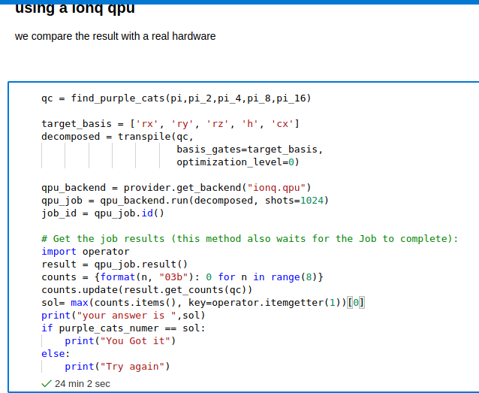
Screenshot(First Modality)
Real quantum computer
simulation

Slide 17
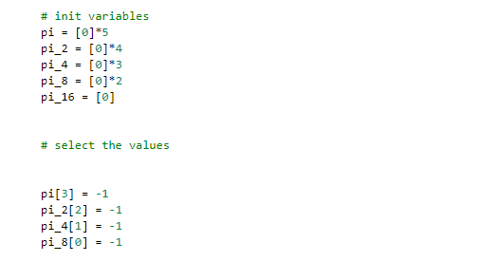
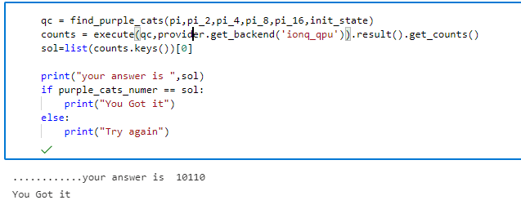
Screenshot(Second Modality)

Slide 18

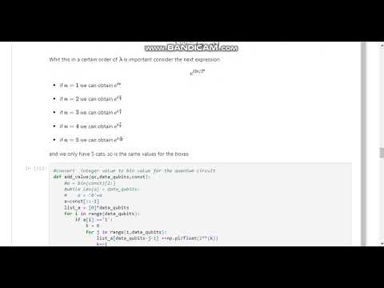
https://youtu.be/zL1ZSIpYx2M

Slide 19
Summary
We developed a quantum random number generator for the target value of the game and the game mechanism is based on a quantum computation algorithm that takes 3 different concepts such as Amplitude Amplification, Quantum Fourier Transform and Arithmetic Operations, in order to relate different concepts in something more superficial and that anyone can practice.
Its purpose is to introduce different concepts and characteristics of quantum computation in an indirect way.
To be able to abstract complex concepts so that only relationships are sought with the little information and motivate the player to interact with the different combinations that are established.

Slide 20
Next Steps
Improving
Extending
Developing
We need to make this video game in an interactive way where animations and transitions show the way to play in order to make it more attractive and friendly for the players.
More qubits can be used and with multiple states or possibilities to show other features such as superposition or Grover's algorithm.
Due to the time constraints of 26 hours, it can be improved in the future to be applicable to an environment suitable for the development and design of video games.

Slide 21
References
Preskill, John. (2018). Quantum Computing in the NISQ era and beyond. Quantum. 2. 10.22331/q-2018-08-06-79.
Draper, Thomas. (2000). Addition on a Quantum Computer.
Ruiz Pérez, Lidia & Garcia-Escartin, Juan Carlos. (2017). Quantum arithmetic with the Quantum Fourier Transform. Quantum Information Processing. 16. 10.1007/s11128-017-1603-1.
https://docs.microsoft.com/en-us/azure/quantum/user-guide/libraries/standard/algorithms
Suau, Adrien & Staffelbach, Gabriel & Calandra, H.. (2020). Practical Quantum Computing: solving the wave equation using a quantum approach.
https://docs.microsoft.com/en-us/azure/quantum/how-to-python-qdk-local
https://docs.microsoft.com/en-us/azure/quantum/user-guide/machines/noise-simulator#:~:text=You%20can%20modify%20the%20noise%20model%20used%20in,then%20access%20the%20noise%20model%20by%20using%20get_noise_model%3A
https://ionq.com/docs/get-started-with-qiskit
https://en.wikipedia.org/wiki/Pseudorandom_number_generator
https://docs.microsoft.com/en-us/azure/quantum/user-guide/libraries/standard/algorithms
https://docs.microsoft.com/en-us/azure/quantum/how-to-python-qdk-local

